Slide 1
End-to-End Retail Performance and Behavioral Analytics
Presented by
t. Abhinav

Slide 2
OVERVIEW
Over the last few years, RetailNova has experienced rapid growth in online orders, especially during the pandemic. However, recent quarters have seen increased product returns, customer churn, and declining profitability in certain regions and product categories. To maintain its market position and plan for the next growth phase, RetailNova’s leadership wants to become more data-driven in its decision-making.
Business Goals:
  Identify key sales trends and anomalies
  Understand customer behavior and segmentation
  Optimize product performance and inventory
  Improve store and regional profitability
  Support decision-making through data visualization and reporting

Slide 3
METHODOLOGY
Data Cleaning & EDA :
Cleaning the raw csv files, adding new columns, changing the datatypes and run the basic EDA using python.
SQL Analysis :
After cleaning the csv files, create a Database, import the cleaned data and solve different business questions.
Data Visualization :
Creating some interactive dashboard using Power BI through the cleaned datasets.

Slide 4
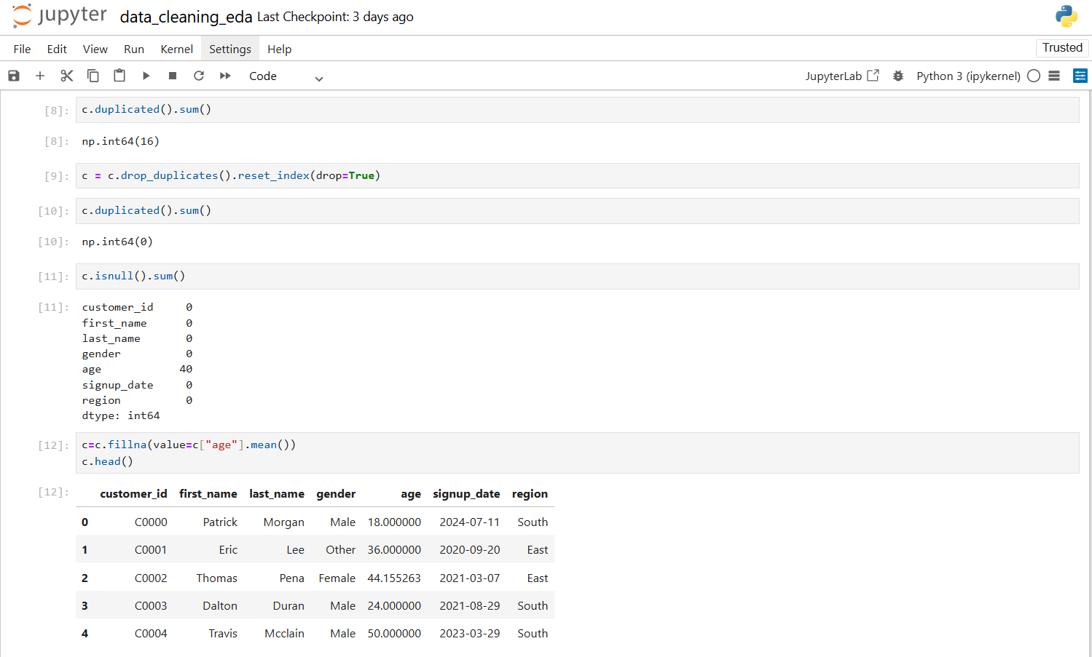

Slide 5
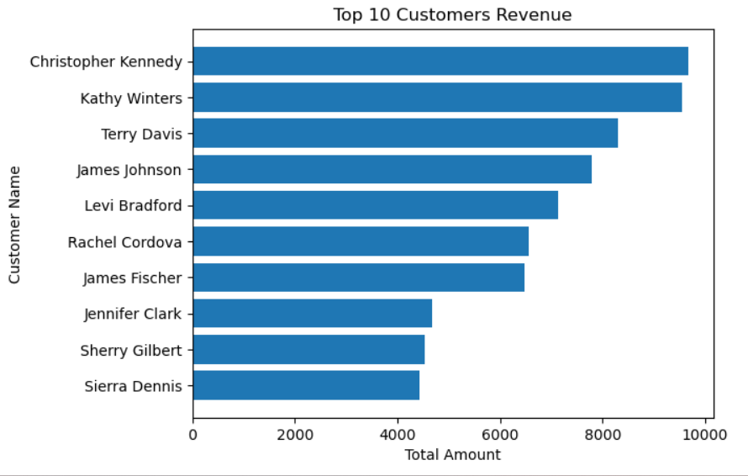

Slide 6
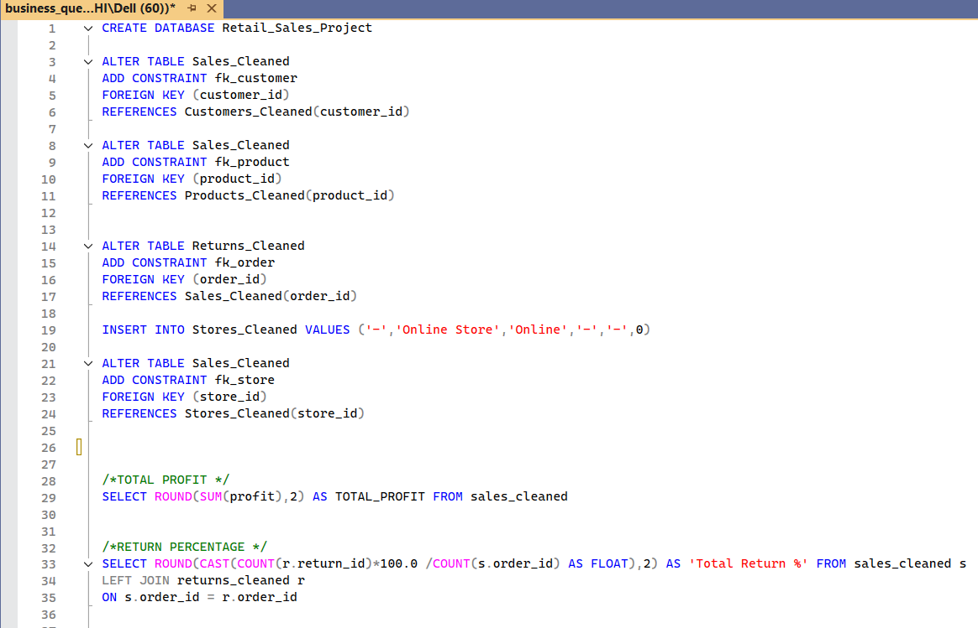

Slide 7
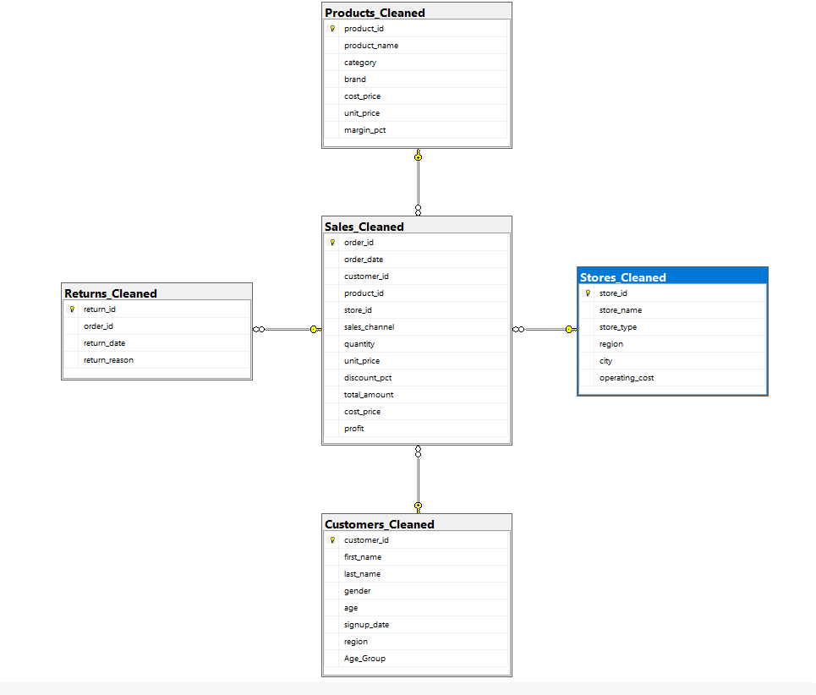

Slide 8
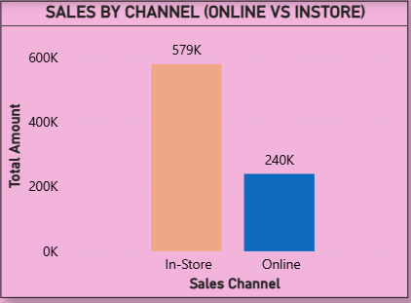
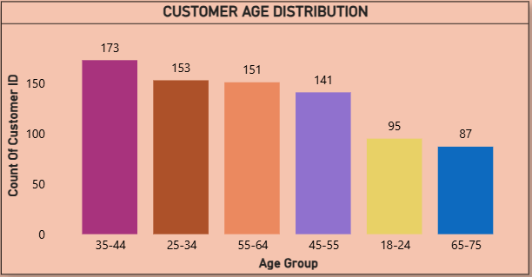
This Bar Chart Shows:
In-store sales dominate at 579K, more than double the 240K generated from online sales.
This Chart indicates :
Customer numbers are highest in the middle aged groups, especially 35–44 and 25–34.
Younger (18–24) and older (65–75) age groups make up the smallest share of customers.

Slide 9
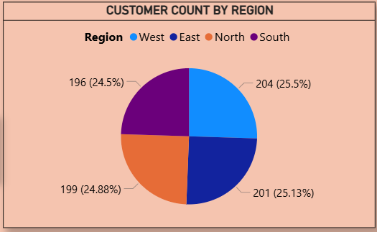
Customer distribution is almost equal across all regions, with each contributing around 25% of total customers.
The West leads slightly with 204 customers, while the South is the lowest at 196, showing a well-balanced market.

Slide 10
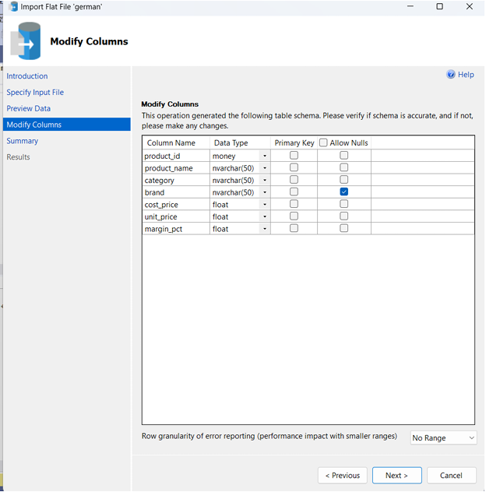
CHALLENGES FACED
During the data import from Excel/CSV into SQL Server, a few columns (such as Product id, Quantity, etc.) were automatically detected and assigned as money or time data types instead of numeric.
Because of this:
  Values did not display correctly
  Query execution failed on those fields

Slide 11
CONCLUSION
The visualizations made it easier to identify which areas are strong and where improvements can be made.
Overall, the reports provided a meaningful overview of the dataset and supported data-driven decision making in a simple and effective way.
The analysis reveals that data-driven decision-making is essential for optimizing sales Trends, customer behavior, product performance and improves store and regional profitability.

